Slide 1
The Superhero Super Database!
By: John Falcone, Hunter Johnson, Ashley Drewry, Patrick Beltran

Slide 2

Overview!
The Pages
The Ink (programming)
The Source Material

Slide 3
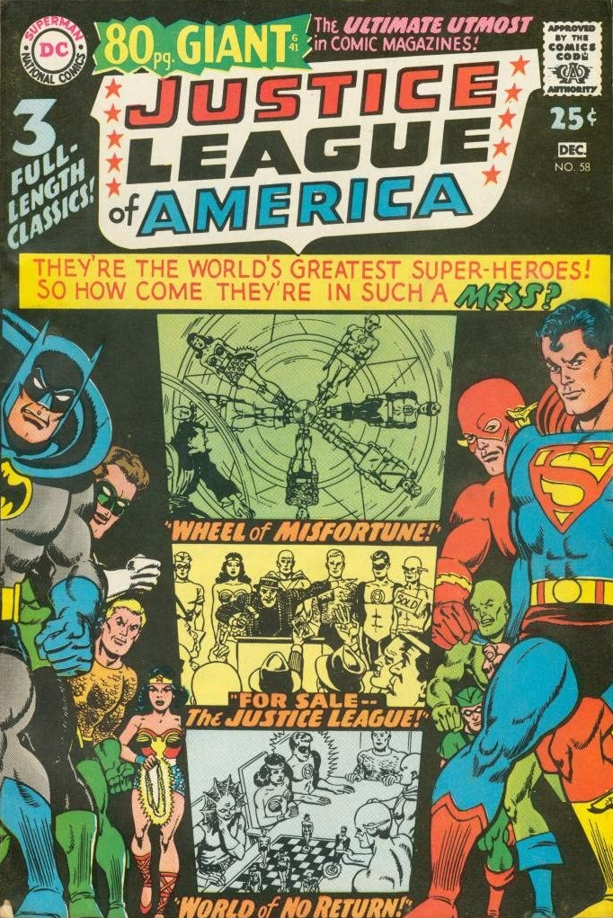

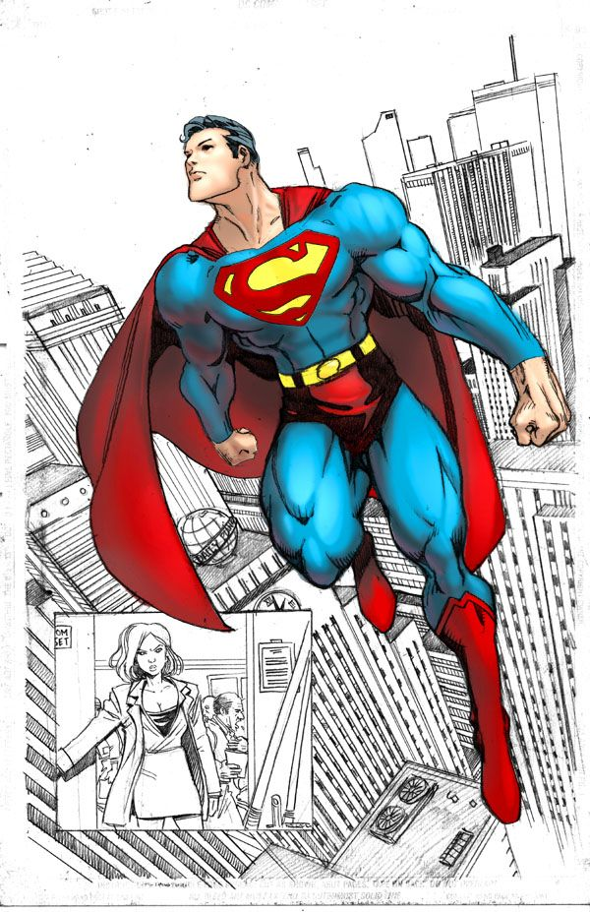
The Pages!

Slide 4
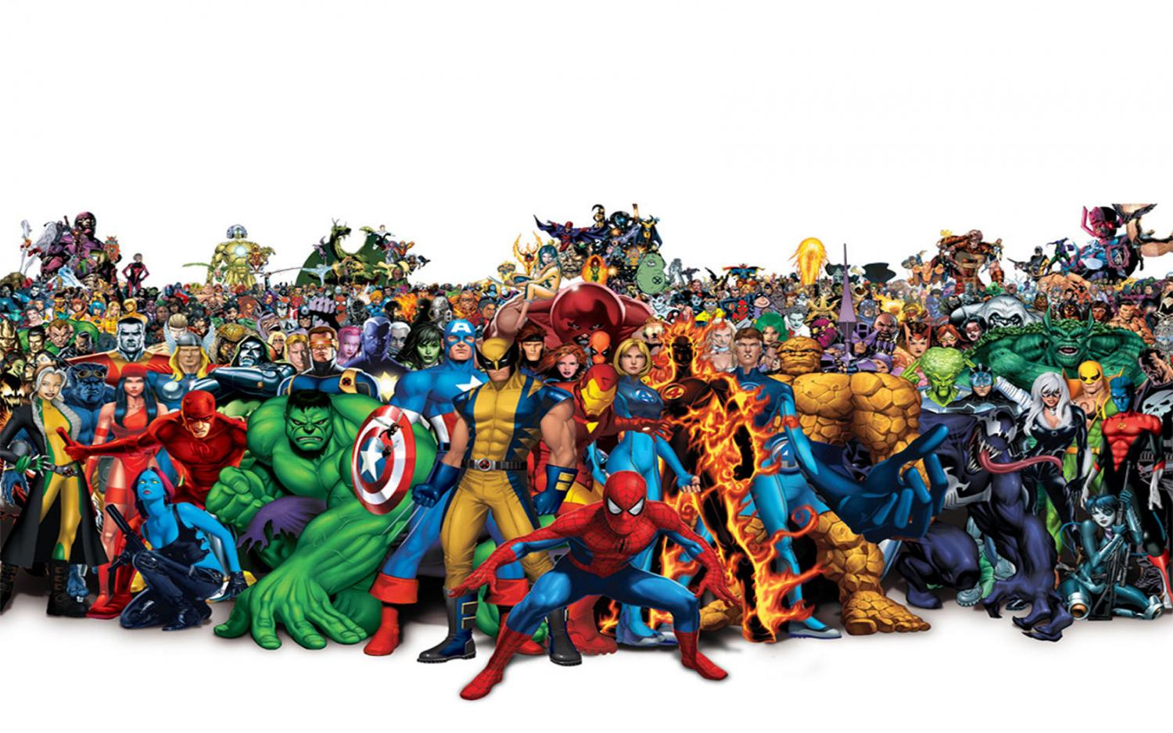
WHAM! Who are these People?
The Bio page
Searchable
Learn the backstory or biography for all the characters

Slide 5
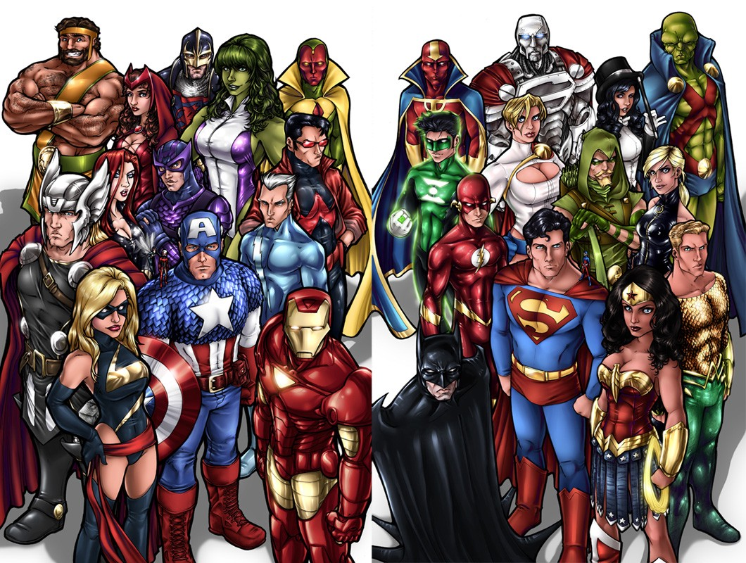
BOOM! Who are the most powerful?
Top 50!
Find out who are the strongest, fastest, best fighters, etc.
Can be sorted by stats

Slide 6
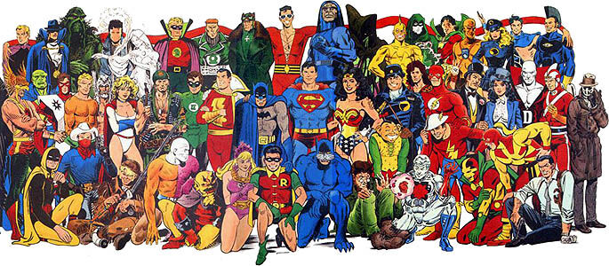
POW! Who is the strongest or smartest?
Power stats page
Searchable list of all characters
Learn their skills and names
Narrow by:
Universe
Alignment
Stats

Slide 7
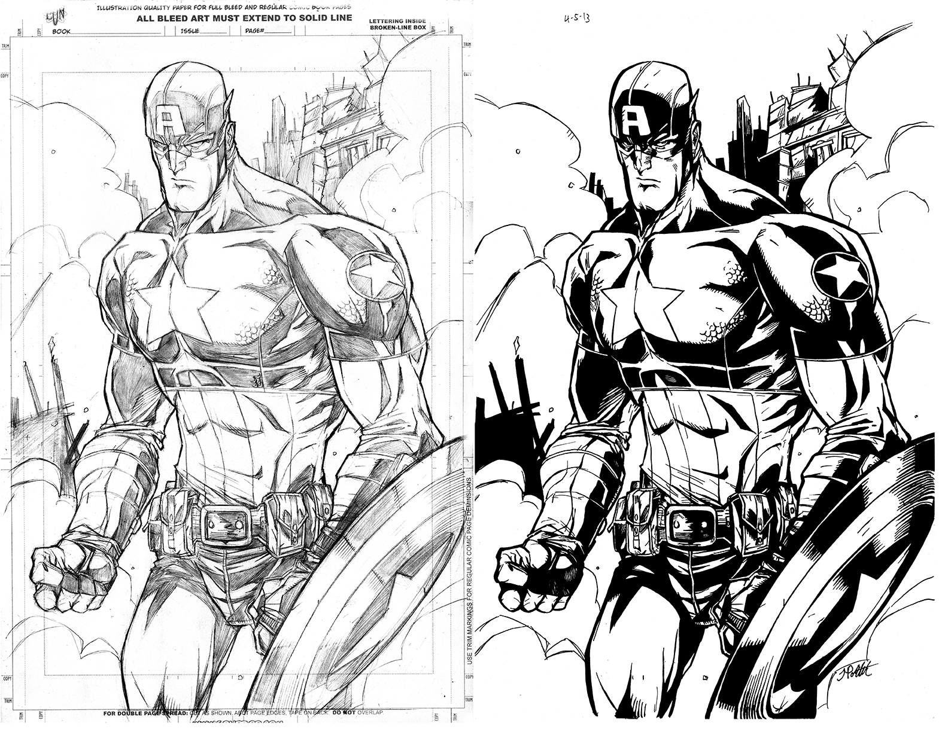
The Ink!

Slide 8

FLASK
It just works!

Slide 9
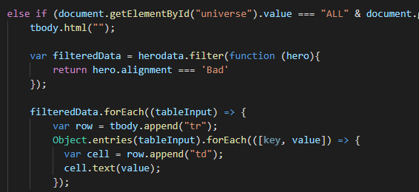
JAVASCRIPT
App.js
Biography.js
Dc_vs_marvel.js
Table.js

Slide 10
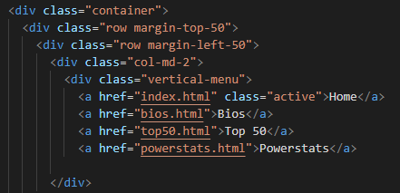
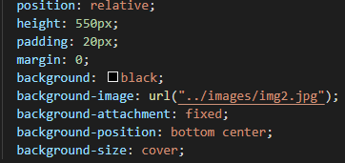
CSS & HTML
Index.html
Powerstats.html
Top50.html
Style.css

Slide 11
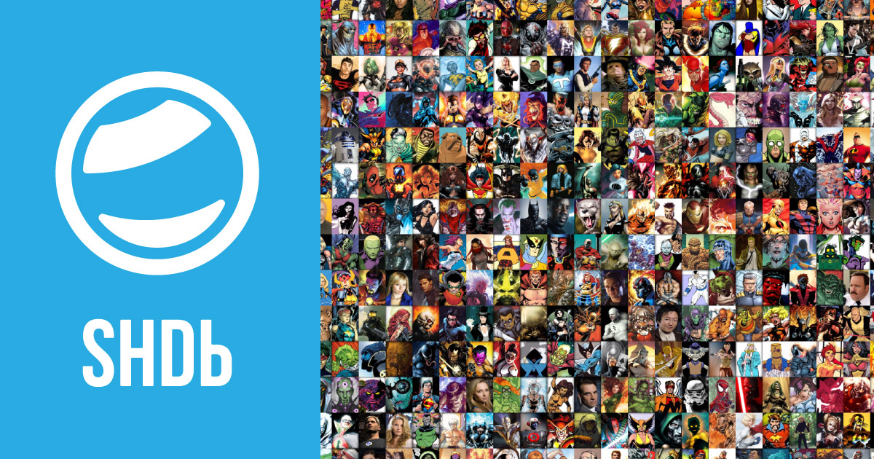
The Source Material
Used Kaggle to obtain data in CSV
SQL to separate data into 2 CSVs
Excel to drop data and create new column

